Slide 1
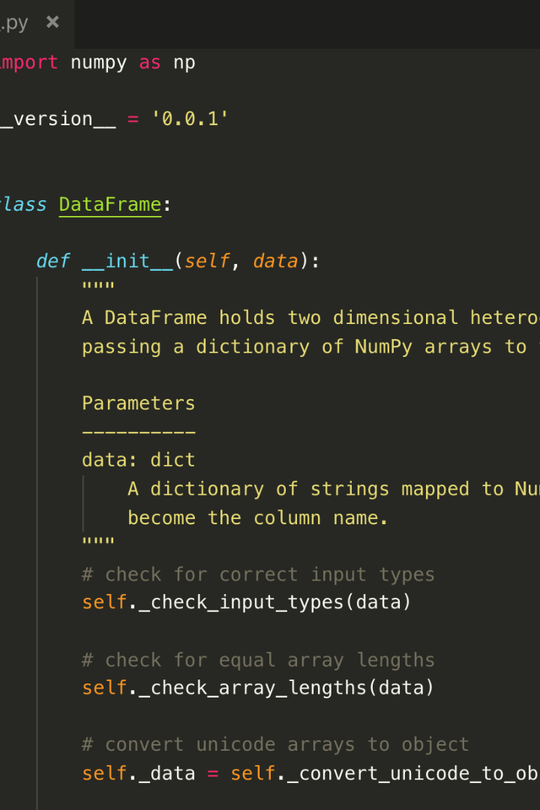


Predicting IMDB Rating Using Python
In this presentation, we will explore how Python can be used to predict IMDB movie ratings by leveraging data analysis and machine learning techniques.
Samsul kula.N

Slide 2

Introduction
Before we dive into the technical details, let's understand why predicting IMDB ratings is important and how it can benefit filmmakers and viewers alike.

Slide 3

Data Collection and Preprocessing
Gather a comprehensive dataset of movies with features and IMDb ratings. - Preprocess the data, including handling missing values, encoding categorical variables (e.g., genres, directors), and normalizing numeric features.

Slide 4

Feature Selection and Engineering
- Select relevant features that are likely to influence movie ratings. - Create new features if needed (e.g., seasonality based on release date).

Slide 5

Data Splitting
- Split the dataset into training and testing sets to evaluate the model’s performance

Slide 6
Model Selection
- Choose an appropriate machine learning algorithm for regression tasks. Common choices include Linear Regression, Random Forest Regression, Gradient Boosting, or Neural Networks

Slide 7

Model Evaluation
performance using metrics like Mean Absolute Error (MAE), Mean Squared Error (MSE), or Root Mean Squared Error (RMSE) on the testing dataset. - Consider using cross-validation for a more robust evaluation.

Slide 8

Conclusion
In conclusion, using Python for predicting IMDB ratings empowers filmmakers to understand audience preferences and viewers to make informed movie choices. By following these steps, you can unlock valuable insights from movie data.

